Slide 1
R605 EEG WORKSHOP
Date: 20250502
Speaker: TingHsin Yen (Ting), ICN, R6111 Brain & Language Lab
Supervisor: Dr. Kevin ChunHsien Hsu

Slide 2
Workshop Outline
1. Introduction of R605 EEG equipment
Brief intro for the involved equipment (i.e. elastic caps, amplifier, trigger box, etc.)
2. User guide of R605 EEG equipment
Rules of EEG equipment reservation (i.e. User logs, key reservations, etc.)
EEG equipment assembly & Things to notices
Experiment testing & Troubleshooting (i.e. gel ratio, impedance)
3. Demo visual & audio experiments using R605 EEG
Software: PsychoPy & Curry (ver 8 & 9)
Demo visual & audio experiments
Data collection procedure
EEG equipment cleaning and R605 space restoration
4. Q & A session
Bring your own questions. Anything related to EEG equipment usage & regulations, and experimental procedure is welcome!

Slide 3
R605 EEG Device Instructions
Please see other files for detailed demonstrations

Slide 4
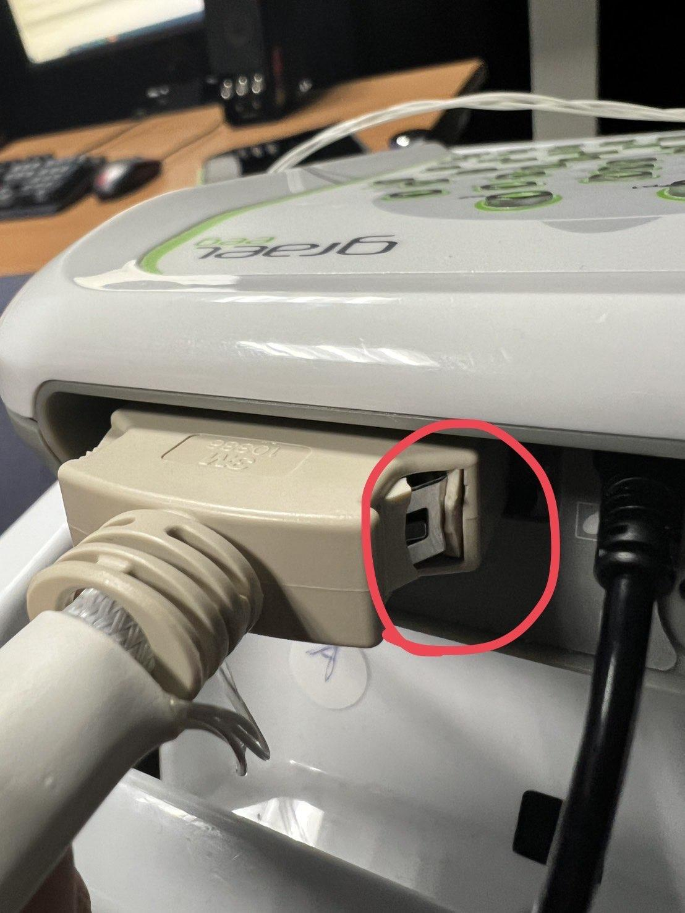
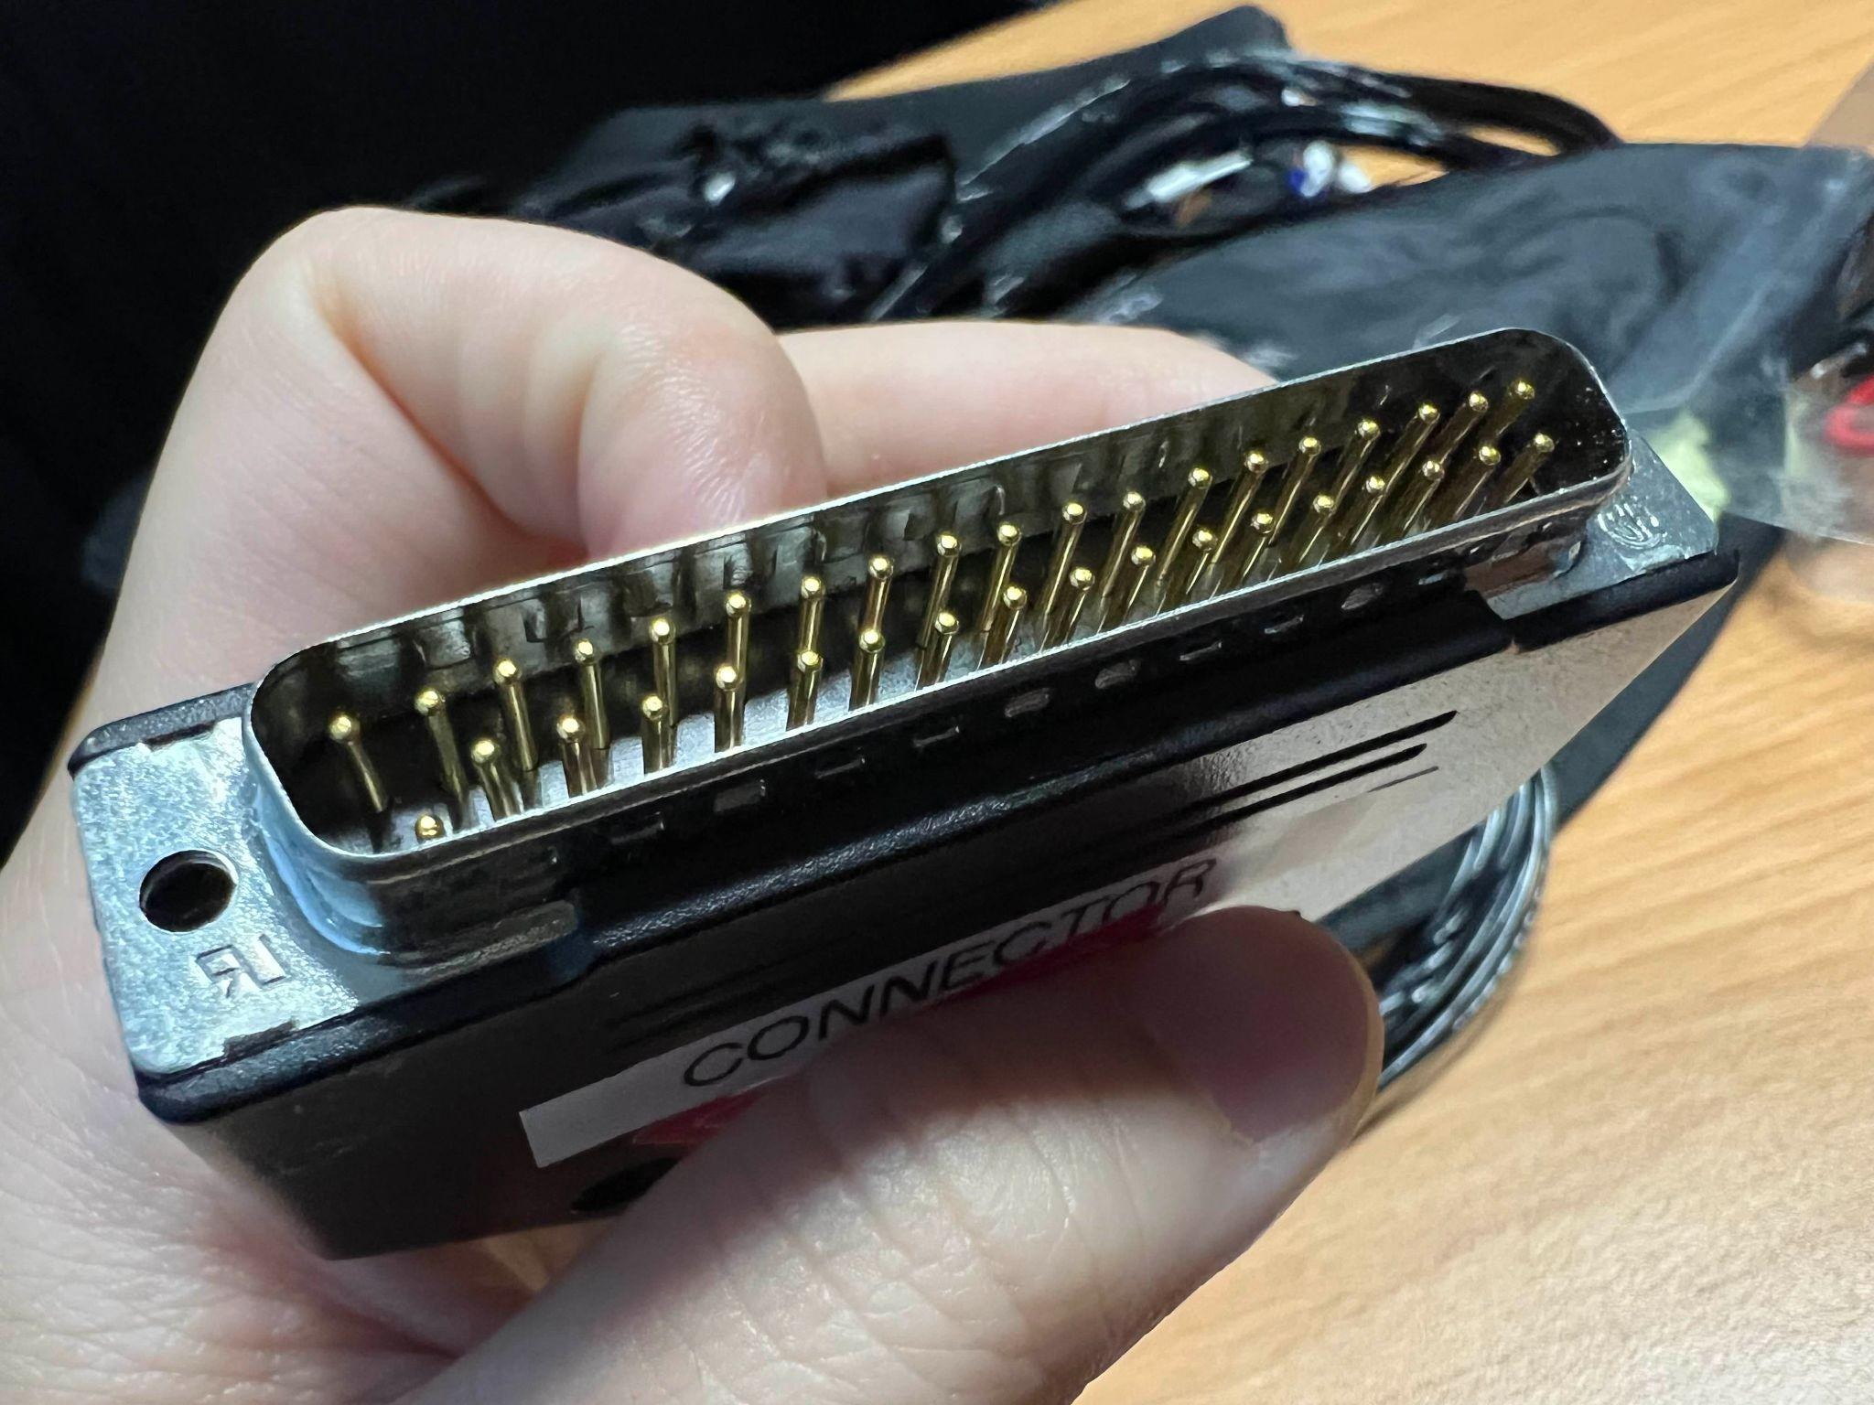
R605 EEG Device

Slide 5
R605 EEG Troubleshooting
Env Setting
Network: key in IP
Psychopy version
EEG Related
Amplifier disconnection
Trigger tags: 1~55 only
Gel Ratio
Impedance
Cap fitting: Size & Unfitted shape
Participants
Health conditions: Fear for needle/syringe, Dizziness, Nausea
Pause for Toilets
Phone / Watch(smart watch)

Slide 6
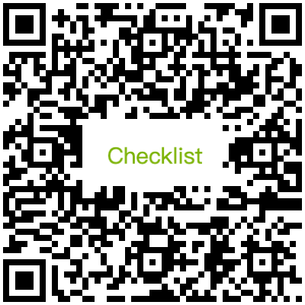
R605 EEG Things to Notice
Participant & Experimental Related
Risk of EEG Experiment
Right of participating the experiment
Instructions:
Experimental Procedures
Expected Responses
Experiment Introduction
EEG Related:
Connectors
Gel ratio
Impedance

Slide 7
Q & A
Q: Are the cap of 64 Channels applicable?
>> Not in R605. Please contact R608 to conduct 64 channels related EEG experiments.
Q: For consumables, how long can we use what is provided by this lab?
>> Depending on the remaining consumables stash. Please inquiry the team for further details.
Q: Is there a faster way to check the conductivity of each channel?
>> After the cap is placed, focus on checking channels with red/high impedance indicators first.
>> Use the EEG Report Form regularly to monitor signal quality and identify recurring issues with specific channels.
Q: How to remove the Windows watermark?
>> License of Windows version might need to update. Please advise the team when watermark reappear.
Q: Which equipment parts may cause signal noise?
Cables: Avoid movement or pulling; loose, dangling cables may introduce noise.
Electrode connectors: Poor contact can degrade signal quality.
Power supply & grounding: Ensure stable power sources and check for electrical interference.
Q: Should the screen and other devices include a fixation marker? Should distance be fixed?
>>A standard distance between participant and screen will be marked. However, experimental design differ from each experiment, all experiment executors are advised to keep a consistent setting for participants in their own experiments. Therefore, necessary measurements should be performed are highly recommend. And please always restore the devices back to its original positions.
Q: Should system and software settings be standardized?
>> A reference (default) setting will be applied, and setting changes are forbidden unless permission is granted by the team. Hence, to prevent influences from inconsistent computer environment settings, please inquiry the team regarding any setting modification.

